Slide 1


IGNITE
Pitch Deck
Milestone 1

Slide 2



Who we are
Name of your Venture: Go Infinity
Why ?
Explain why do you want to pursue this Business Idea.
We want to provide sustainable fashion to the users by reducing the demand for new clothing production.
What ?
Provide a brief on what does your venture do.
We build a website which enables the user/customers that promote the reusage of clothing, by reselling the clothes.
How ?
Explain how your venture solves the problem and make its revenue.
People invest huge amounts of money on buying branded clothing and they remain unused after few usage, therefore we will enable the concept of thrifting on our website which allow the customers to resell them.

Slide 3

Problem/Opportunity
Place your logo here
CONTEXT When does the problem occur? When people get bored of using their clothing. When their clothes doesn’t fit after a duration of time. | PROBLEM What is the root cause of the problem? When people have huge amount of unused or stored clothes/items. | ALTERNATIVES What do customers do now to ﬁx the problem? Sell their unused clothes/items. People who can’t afford can now buy the branded items at a lower price.
CUSTOMERS Who has the problem most often? Fashion bloggers. Shopping Freaks | EMOTIONAL IMPACT How does the customer feel? Feel happy about saving money. | ALTERNATIVE SHORTCOMINGS What are the disadvantages of the alternatives? Unnecessary spending of money. Wastage of unused clothing.
 | QUANTIFIABLE IMPACT What is the measurable impact (include units)? 100
This table helps you define the problem and existing market gaps.

Slide 4
Problem Interviews And Surveys Results
Place your logo here
How many customers did you interview?
Answer: 20
What was the interview mode?
Answer: Offline
How many of them agree this is a problem and wants a solution?
Answer: 6
How many of them said they don't need a new solution?
Answer: 4
The aim of this slide is to capture the customer responses to substantiate and validate the problem your venture is solving. Present result analysis of the problem interviews conducted with your potential customers in graphical representation.

Slide 5
Market Size Estimation
Place your logo here
TAM
SAM
SOM
How to calculate market size?
1. Start with Total Addressable market – 10,800 lakhs.
TAM refers to the total market demand for a product or service.
If you’re entering a pre-existing space (like small business banking) you can research it and provide credible sources or reference points on how you arrived at the TAM. If you’re creating a new product or space (like Slack), you can estimate the number of customers that would want your product and approximate how much you could charge them.
2. Take your target market (SAM), within that TAM, which varies depending on geography and other logistical factors. Determine the penetration potential of your target market. This is the portion of the market you can reasonably compete with 1080 lakhs.
3.By conducting research with existing competitors, distributors etc., understand the likely penetration rate 10%.
4. Multiply target market by penetration rate to find your market size 1,80,000.
.
This slide is to provide details on Market Size and demonstrate How big is the market opportunity your venture is pursuing. Add source/reference to the data presented.
Sources: ……

Slide 6

Customer Persona
Creative
Value related
Authentic
Motivations
Photo
Goals
To save money
To try new fashion
Frustrations
Huge amount of unused clothing.
Bored of using same clothing.
Malar
Age: 20
Occupation: Student
Location: Vijayawada
Bio
I am Malar. I am a student and content creater. I want to use
branded clothes at a low prices which helps me in saving
money.
The aim is to collect the information about your ideal customer persona who are likely to buy your product or service . It will help you tailor the user experience through targeted design.
Personality
Notes:
Time: 7 mins
Get students to brainstorm on the customer persona and VPC

Slide 7
Value Proposition Canvas
Place your logo here
.
What do you offer that makes the customers happy?
Low price branded clothing.
Huge sales.
I would LOVE it if:
What would make the customer happy?
Affordable Clothing
Good Quality
What do the clients want when facing the problem?
They cannot resell their clothes
More wastage
What is the product or service that you are offering?
Thrifting
I would WANT:
What do the clients do (actions) when facing the problem?
They look for cheaper options
They put them to waste
GAIN CREATORS
FIT
GAINS
PRODUCT/
SERVICE
JOBS
PAIN KILLERS
PAINS
Which features of your offering relieve the customer's pains?
Low prices.
Good quality.
I would HATE it if:
What are the pains of the clients when facing the problem?
They couldn’t afford good quality clothing.
High investmnets on clothing.
Demonstrate the fit between what you are offering and why people buy it. You must build on solution (products & service) that match their needs ( pains & gains).

Slide 8
Solution
Place your logo here
Describe your Solution:
We offer Online Thrifting Service.
The details of our offering consist of:
Low pricing.
Quality Clothing.
Huge deals.
List the Benefits of Your solutions
1. Save money.
2. No wastage of clothes.
3. Affordability.
Notes:
Evaluation Criteria for slides 8 and 9
Check the following on the correctness of VPC: a. Have you identified the correct pains & gains; pain relievers & gain creators (2 marks) b. Have you identified the correct Jobs-to-be-done? (1 mark) c. Are the pain relievers addressing the customer pains? (1 mark) d. Have you identified the right value proposition so that the solution makes the customer's life better? (1 mark)

Slide 9



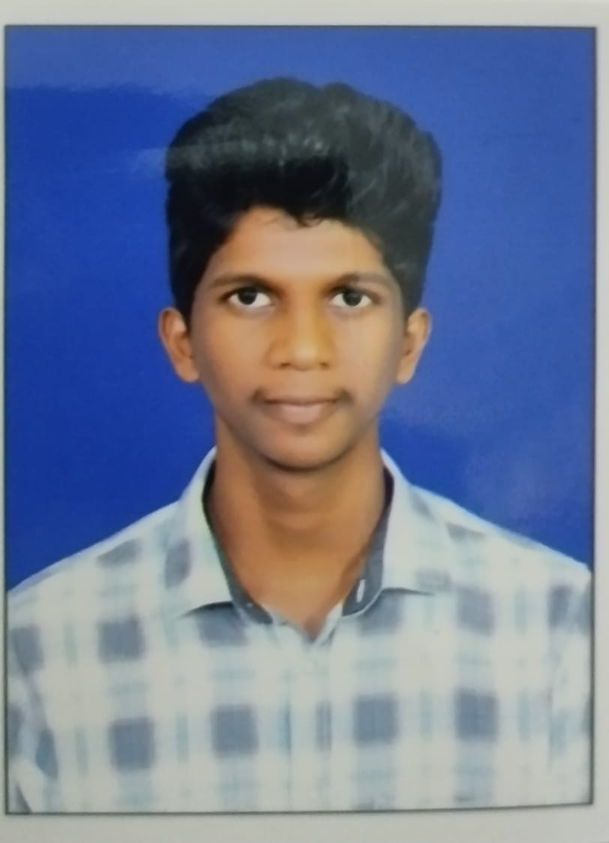
Team Composition
Team member 4
Team member 1
Team member 2
Team member 3
Place your logo here
Picture
Picture
Picture
Picture
What makes us a good team to solve the problem we chose?
We are collaborative and communicative.
Open communication
Defined goals
Provide constructive criticisim.
Showing respect to everyone
Providing quality feedback on each others work.
Role/Position:
CEO
Role/Position:
COO/CTO
Role/Position:
CFO/CMO
Role/Position:
CDO/CPO
Key Strengths and abilities :
Leadership
Adaptability
Communication
Problem solving
Key Strengths and abilities
Decision Making
Strategic Planning
Strategy making
Conflict resolution
Key Strengths and abilities :
Communication
Analytic Skills
Integrity
Financial foresight
Key Strengths and abilities :
Strategic vision
Technical expertise
Problem solving skills
The goal is to demonstrate teams commitment. Mention who’s on your team, why them and their extremely relevant credentials

Slide 10
Thank You!

